Slide 1
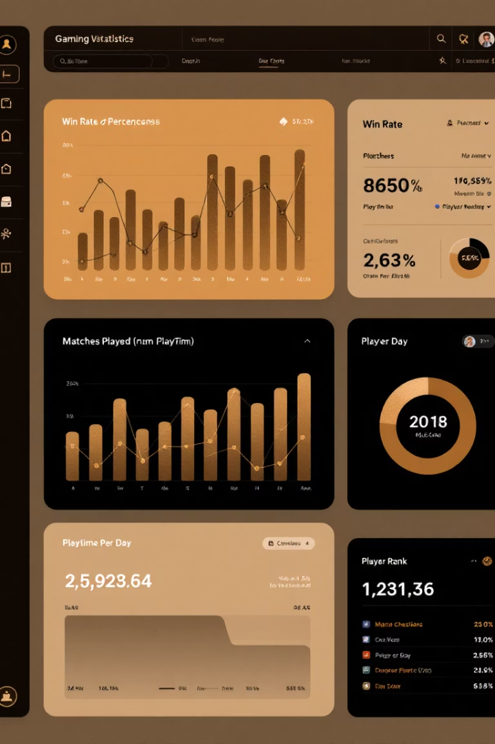

Matiks Gaming Data Analysis
Key findings from analyzing 10,000 gaming user records
by ishita bahamnia

Slide 2
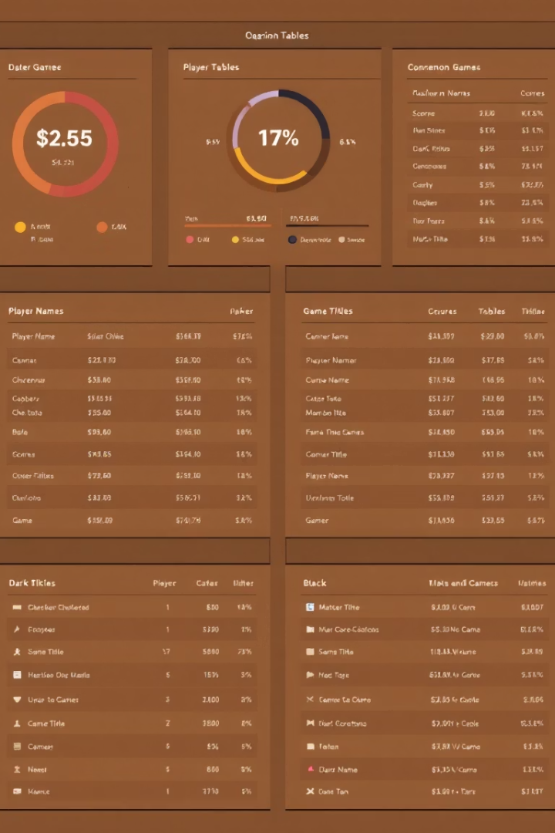



Dataset Overview
10,000 records
User demographics
20 features, no missing values
Age, gender, country, device type
Gaming metrics
Play time, revenue, achievements

Slide 3



Data Cleaning Challenges
Identify outliers
215 negative play hours found
Clean values
Replace negative hours with zero
Verify results
Confirm data integrity

Slide 4
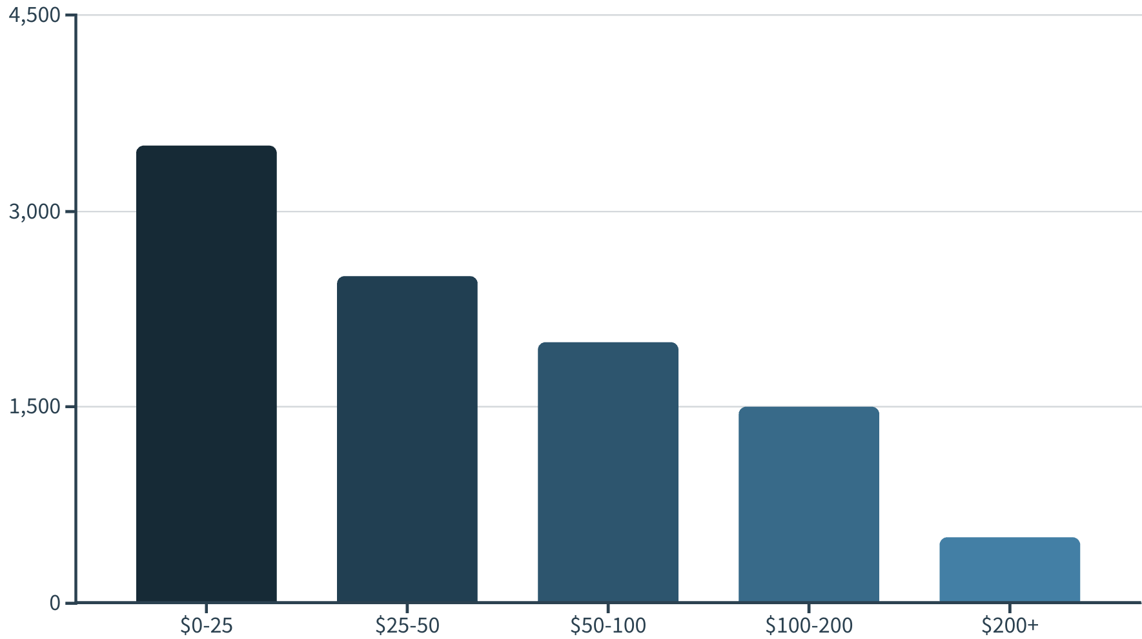
Revenue Distribution
Most users spend under $50, with a small segment of high-value customers spending over $200

Slide 5
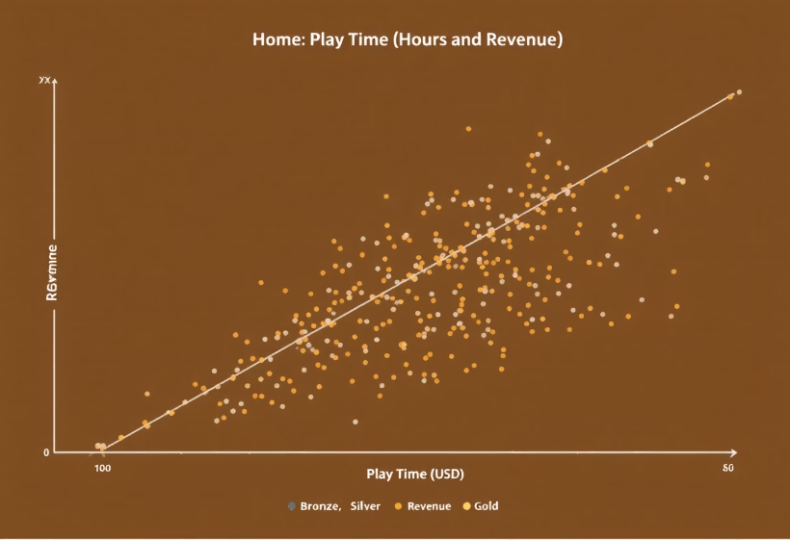
Revenue vs. Play Time
Key Observations
Positive correlation between hours and revenue
Gold tier shows steepest revenue growth
Free tier has lowest revenue per hour

Slide 6
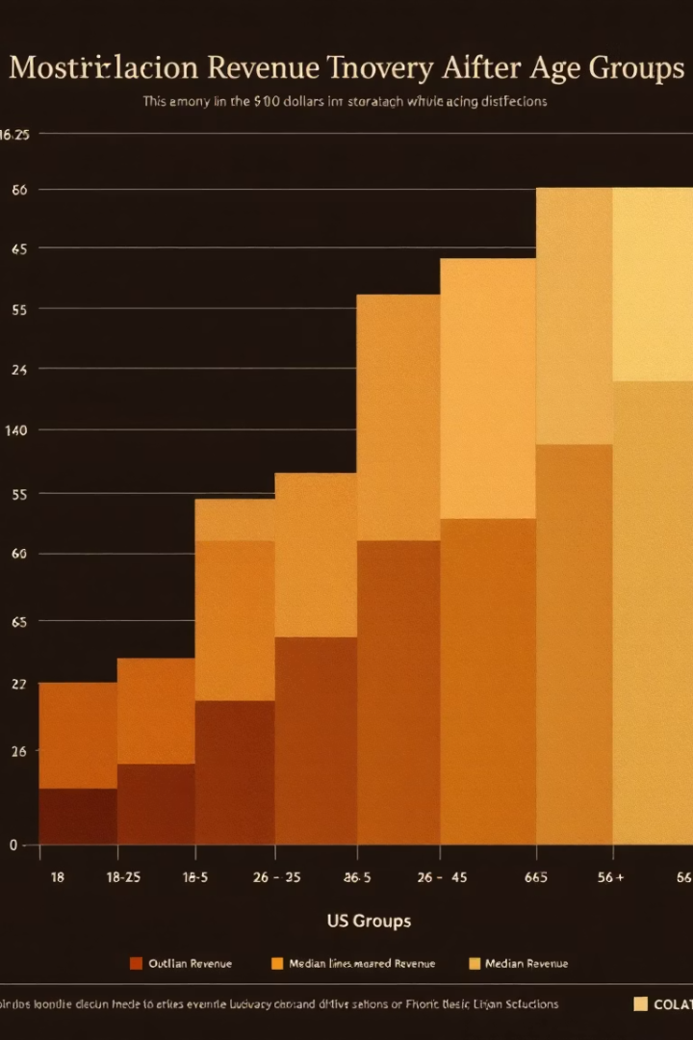
Revenue by Age Group
0-18 Age Group
Lower median revenue
Fewer outliers
19-25 Age Group
Moderate spending
Some high-value outliers
26-35 Age Group
Highest median revenue
Most valuable customer segment
36-50 Age Group
Declining revenue trend
Still contains valuable outliers

Slide 7
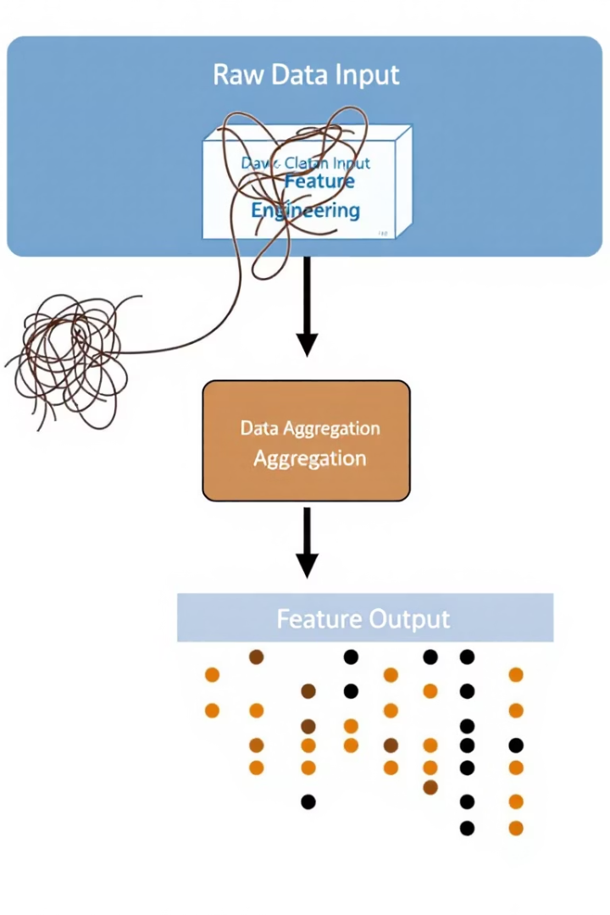



Feature Engineering
Revenue Per Hour
Created from revenue divided by play time
Date Conversion
Signup and login dates to datetime format
One-Hot Encoding
Categorical variables expanded to 272 columns

Slide 8








Key Insights & Next Steps
Revenue Patterns
Play Time Impact
26-35 age group most valuable
Strong correlation with revenue
Next Analysis
Subscription Tiers
Explore demographics and game preferences
Gold tier shows highest revenue growth

